Slide 1

Prediction of Housing Prices in Boston Using Machine Learning Algorithms
Rabia Danish Student Number: 501210698 Supervisor’s Name: Professor Dr. Ceni Babaoglu Date of submission: 24th July 2023

Slide 2

Introduction
In today's ever challenging world of real estate, where housing prices are constantly on the rise, it has become increasingly important for individuals to make well-informed decisions when it comes to property investments. The objective of this supervised ML regression project is to determine the best model to predict the house prices in Boston.

Slide 3

Problem Statement
How can feature selection techniques, including correlation analysis, be employed to identify the key factors influencing housing prices?
In addition to multiple linear regression, how do advanced regression algorithms such as random forest and decision tree regression contribute to improving the predictive accuracy of the housing price model?
How can the performance of different models be evaluated and compared using appropriate metrics such as mean absolute error (MAE) , Mean Squared error (MSE), root mean squared error (RMSE) and R2 squared?

Slide 4








Methodology
Conclusion
The key findings of the study are summarized, and recommendations for future research or actions are provided based on the results.
Data Collection
Housing price Data was collected from Kaggle.
Approach
Data Preparation
Prepare data for analysis.
Result Interpretation
The results of the analysis are interpreted.
Data Visualization Perform exploratory data analysis (EDA) to gain insights into the dataset, identify patterns, and understand the relationships between features and the target variable
Model Evaluation
Evaluate the trained models using evaluation metrics MAE, MSE, RMSE, and R2.
Model Selection
Machine learning techniques linear regression, decision tree regression, and Random Forest is used to develop predictive models for housing price estimation.
Model Training
The prepared dataset is used to train the models using three machine learning algorithms The 10-fold cross-validation technique is employed.

Slide 5
Exploratory Data Analysis (EDA)
Dataset Statistics
Number of Variables | 13
Number of Rows | 545
Missing Cells | 0
Duplicate Rows | 0
Variable types | Numerical: 2 Categorical: 11
Attributes | # of Outliers | % of Outliers
Price | 6 | 1.10%
Area | 7 | 1.28%
Bedrooms | 2 | 0.37%
Bathrooms | 11 | 2.02%
Stories | 0 | 0%
Parking | 0 | 0%
Attribute | Min | Max | Mean | Median | Standard Deviation
Price | 1.750000e+06 | 1.330000e+07 | 4.766729e+06 | 4.340000e+06 | 1.870440e+06
Area | 1650 | 16200 | 5150.54 | 4600.00 | 2170.14
Bedrooms | 1.00 | 6.00 | 2.965 | 3.00 | 0.738
Bathrooms | 1.00 | 4.00 | 1.286 | 1.00 | 0.502
Stories | 1.00 | 4.00 | 1.805 | 2.00 | 0.867
Parking | 0 | 3.00 | 0.693 | 0 | 0.861

Slide 6
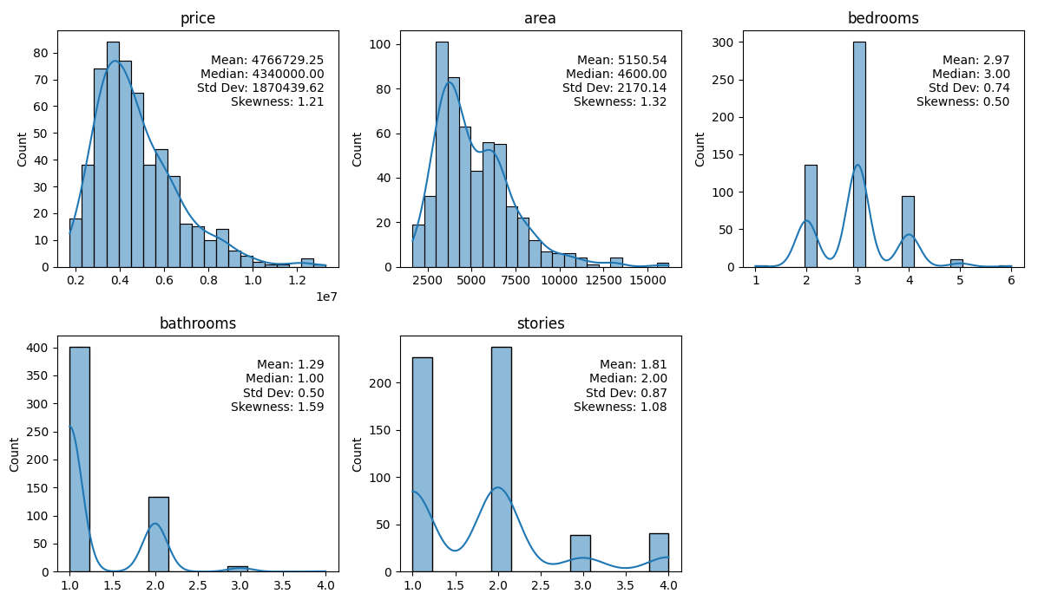
Univariate Analysis

Slide 7
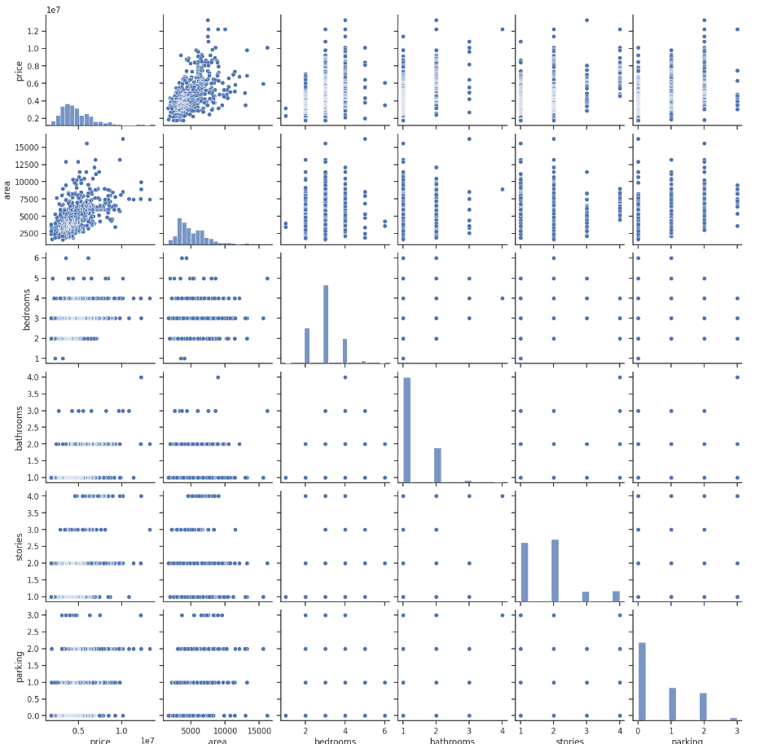
Bivariate Analysis

Slide 8
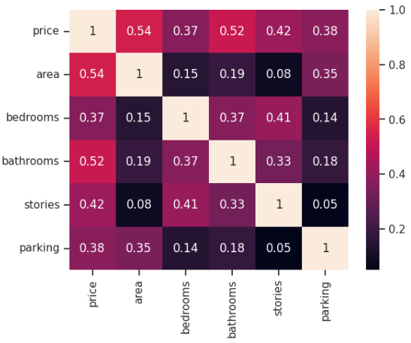
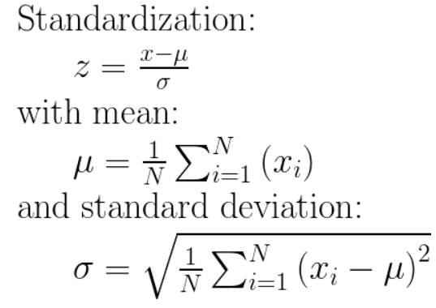
Data Normalization
Categorical Variable Encoding
Feature selection
Correlation Analysis
Label Encoding Assigns each label with a unique integer value.
Area, bedrooms, bathrooms, stories, mainroad, airconditioning, parking, prefarea, finishing status

Slide 9
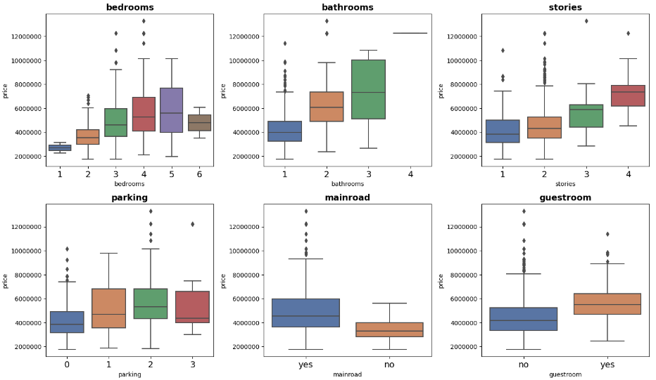
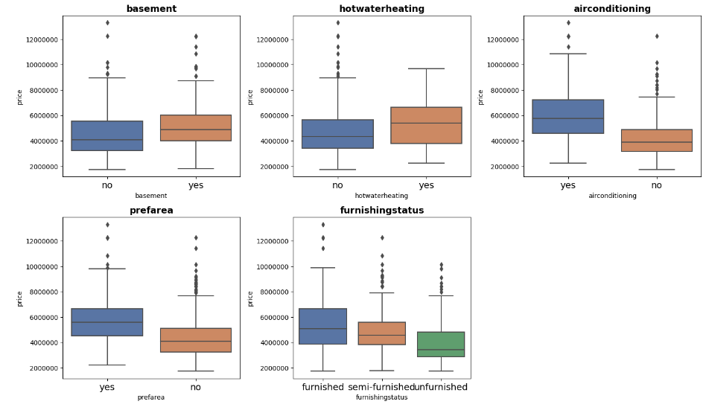
Data Visualization
The box plot shows a visual representation of the central tendencies, range, median, outliers and variabilities of the attributes.

Slide 10
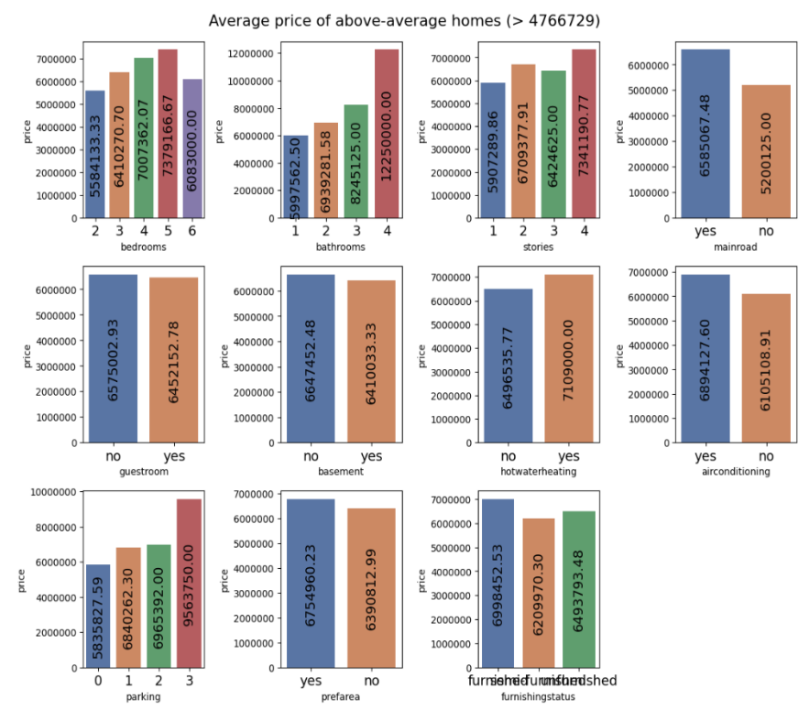
Data Visualization
Houses with more bedrooms, bathrooms, and stories tend to have higher average prices, indicating that larger and more spacious properties. command higher values.
Furnished houses have higher average prices compared to semi-furnished or unfurnished ones.
The presence of a basement, hot water heating, air conditioning, parking availability, and preferred area also contribute to price variations.

Slide 11

Machine Learning Algorithms
Linear Regression
Linear regression provides interpretable coefficients that quantify the relationship between the independent variables and the dependent variable. These coefficients represent the change in the dependent variable for a unit change in the corresponding independent variable, holding other variables constant.
Decision Tree
Decision trees provide a transparent and easy-to-understand representation of the decision-making process. The tree structure consists of a series of if-else conditions based on the values of the input features, leading to a final decision or prediction.
Random Forest
Random Forest is a powerful ensemble learning algorithm that combines the predictions of multiple decision trees to make accurate predictions.

Slide 12
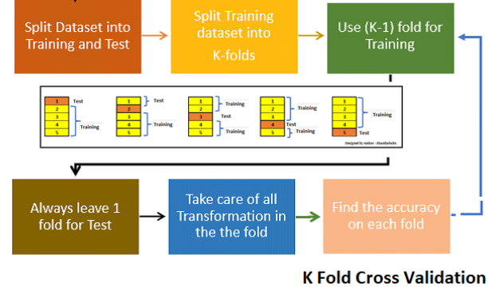
Model Selection and Model Training
The prepared dataset is used to train the models using three machine learning algorithms (Linear Regression, Decision Tree, and Random Forest).
The 10-fold cross-validation technique is employed to assess the performance of a model on unseen data by splitting the available data into multiple subsets or folds.
MAE, MSE, RMSE and R2 values are compared for all 3 machine learning algorithms first on all features and then on the selected features and the model that gives lower value of MAE, MSE and RMSE and higher value of R2 is selected.

Slide 13
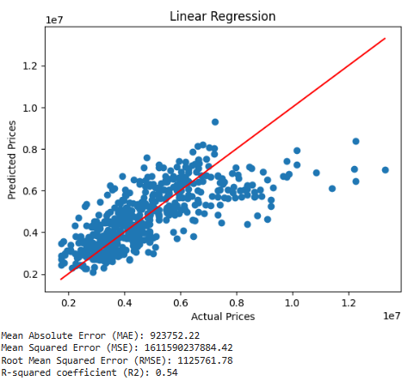
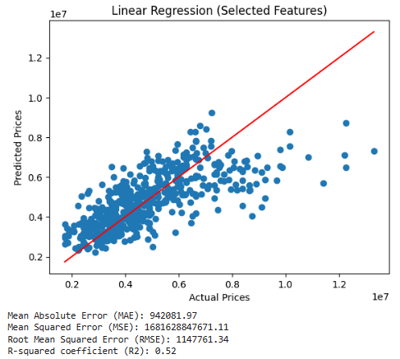
Linear Regression Model
The linear regression model on all features, lower values of MAE, MSE, and RMSE indicate better performance. The MAE of 923,752.22 indicates that, on average, the model's predictions deviate from the actual values by approximately 923,752.22. The RMSE of 1,125,761.78 indicates the average prediction error of the model is around 1,125,761.78. The R-squared coefficient of 0.54 indicates that approximately 54% of the variability in the target variable can be explained by the linear regression model. The linear regression model on the selected features shows slightly worse performance compared to the linear regression model built using all features.

Slide 14
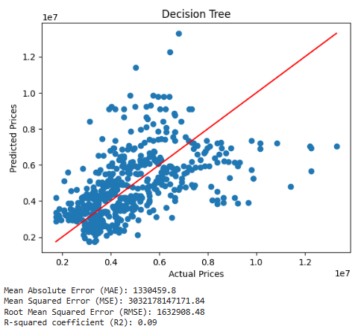
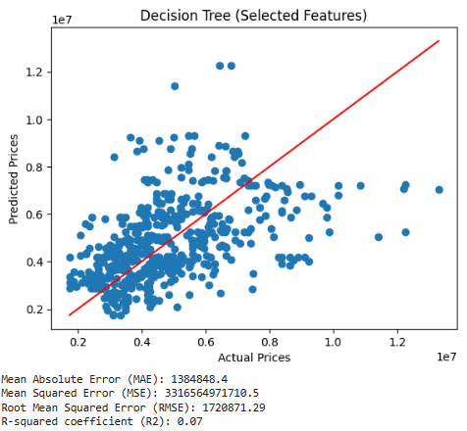
Decision Tree Model
The decision tree regression model based on all features has higher MAE, MSE, and RMSE values compared to linear regression indicate that the decision tree model's predictions have higher errors.

Slide 15
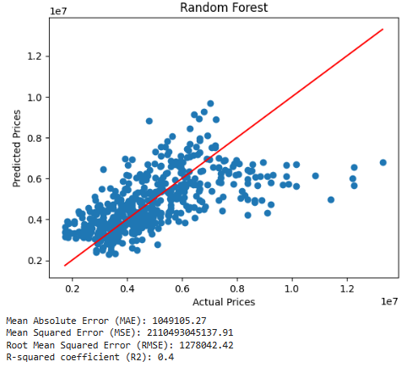
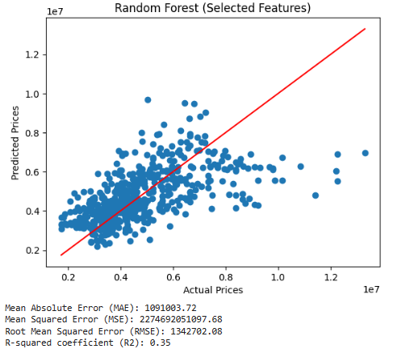
Random Forest Model
The Random Forest model on all features MAE, MSE and RMSE values are lower compared to the decision tree, indicating that the random forest model performs better in terms of prediction accuracy as compare to decision tree but worse than linear regression.

Slide 16
Overall Result Comparison
Machine learning Algorithms | On All Features |  | On Selected Features
Linear Regression | Mean Absolute error (MAE) | 923752.22 | Mean Absolute error (MAE) | 942081.97
 | Mean Squared error(MSE) | 1611590237884.42 | Mean Squared error(MSE) | 1681628847671.12
 | Root Mean Squared Error (RMSE) | 1125761.78 | Root Mean Squared Error (RMSE) | 1147761.34
 | R-squared coefficient (R2) | 0.54 | R-squared coefficient (R2) | 0.52
Decision Tree | Mean Absolute error (MAE) | 1330459.8 | Mean Absolute error (MAE) | 1384848.4
 | Mean Squared error(MSE) | 3032178147171.84 | Mean Squared error(MSE) | 3316564971710.5
 | Root Mean Squared Error (RMSE) | 1632908.48 | Root Mean Squared Error (RMSE) | 1720871.29
 | R-squared coefficient (R2) | 0.09 | R-squared coefficient (R2) | 0.07
Random Forest | Mean Absolute error (MAE) | 1049105.27 | Mean Absolute error (MAE) | 1091003.72
 | Mean Squared error(MSE) | 2110493045137.91 | Mean Squared error(MSE) | 2274692051097.68
 | Root Mean Squared Error (RMSE) | 1278042.42 | Root Mean Squared Error (RMSE) | 1342702.08
 | R-squared coefficient (R2) | 0.4 | R-squared coefficient (R2) | 0.35

Slide 17

Conclusion
The linear regression model performs the best among the three models, providing relatively lower prediction errors and a higher R-squared coefficient. The decision tree and random forest models exhibit higher errors and lower R-squared coefficients, indicating poorer performance compared to linear regression. However, it's important to note that the high MAE, MSE, and RMSE values are primarily due to the larger scale of the target variable "price" (in millions).

Slide 18
Future Work
1
Working on a larger dataset with more samples can help to improve the accuracy of models and provide more robust results.
2
Other models or variations of these models that could be worth exploring.
3
Further tuning of hyperparameters may be required.

Slide 19
References
H, M. Y. (2022, January 12). Housing prices dataset. Kaggle. https://www.kaggle.com/datasets/yasserh/housing-prices-dataset
Pandian, S. (2023, July 14). K-fold cross validation technique and its essentials. Analytics Vidhya. https://www.analyticsvidhya.com/blog/2022/02/k-fold-cross-validation-technique-and-its-essentials/
Zhang, Q. (2021). Housing price prediction based on multiple linear regression. Scientific Programming, 2021, 1–9. https://doi.org/10.1155/2021/7678931
Gupta, A. (2023, April 26). Feature selection techniques in Machine Learning (updated 2023). Analytics Vidhya. https://www.analyticsvidhya.com/blog/2020/10/featureselection-techniques-in-machine-learning/
How linear regression algorithm works. How Linear regression algorithm works-ArcGIS Pro | Documentation. (n.d.). https://pro.arcgis.com/en/pro-app/latest/toolreference/geoai/how-linear-regression-works.htm
How decision tree classification and regression algorithm works. How Decision tree classification and regression algorithm works-ArcGIS Pro | Documentation. (n.d.). https://pro.arcgis.com/en/pro-app/latest/tool-reference/geoai/how-decision-treeclassification-and-regression-works.ht
Turing Enterprises Inc. (2022, March 24). Data normalization with Python Scikit-Learn: Tips for Data Science. Data Normalization with Python Scikit-Learn: Tips for Data Science. https://www.turing.com/kb/data-normalization-with-python-scikit-learn-tips-tricks-for-data-science

Slide 20


“Let it be the beginning of the new
Journey.”

